Slide 1
Doctor Search
Group 21

Slide 2
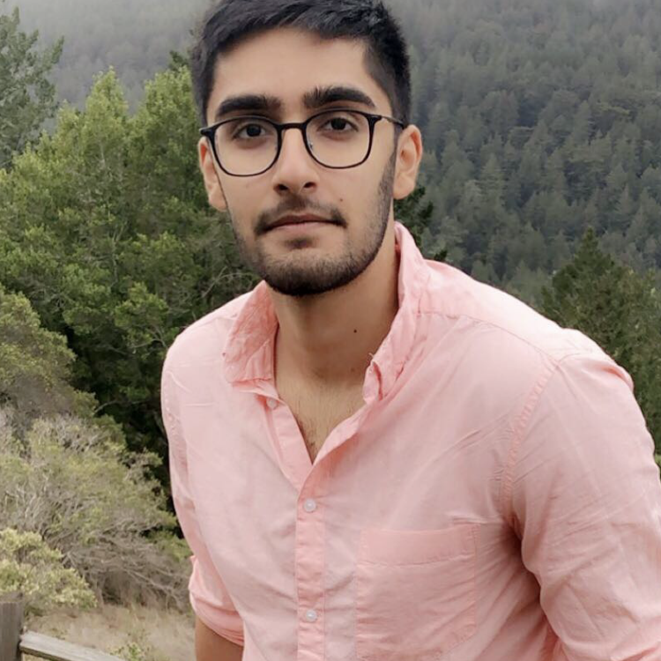
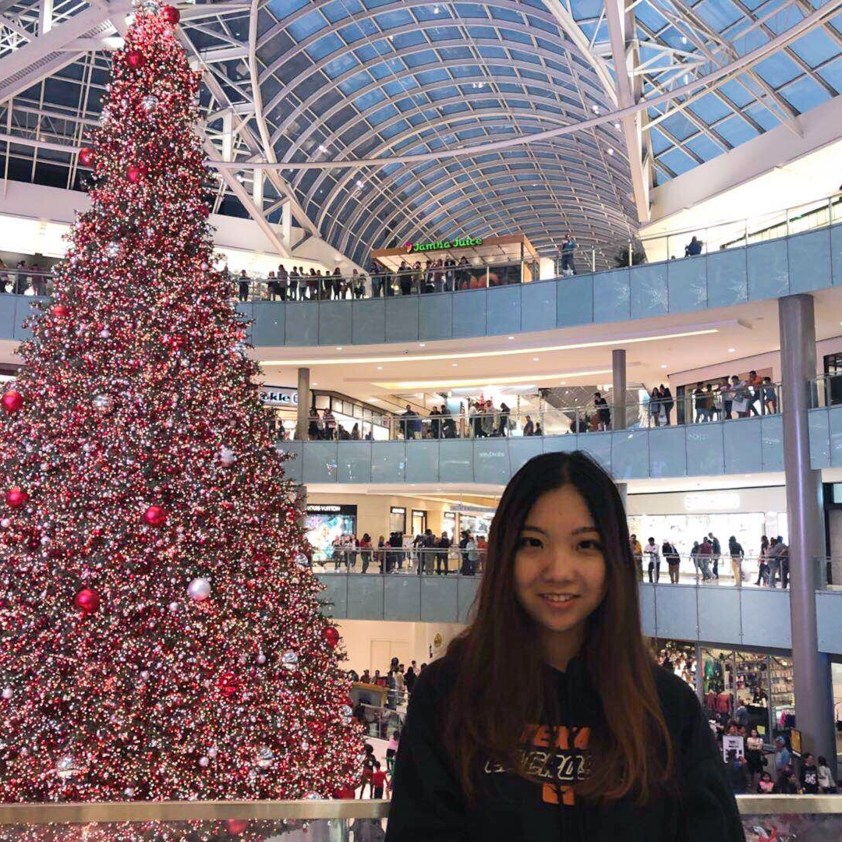
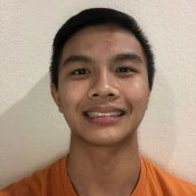
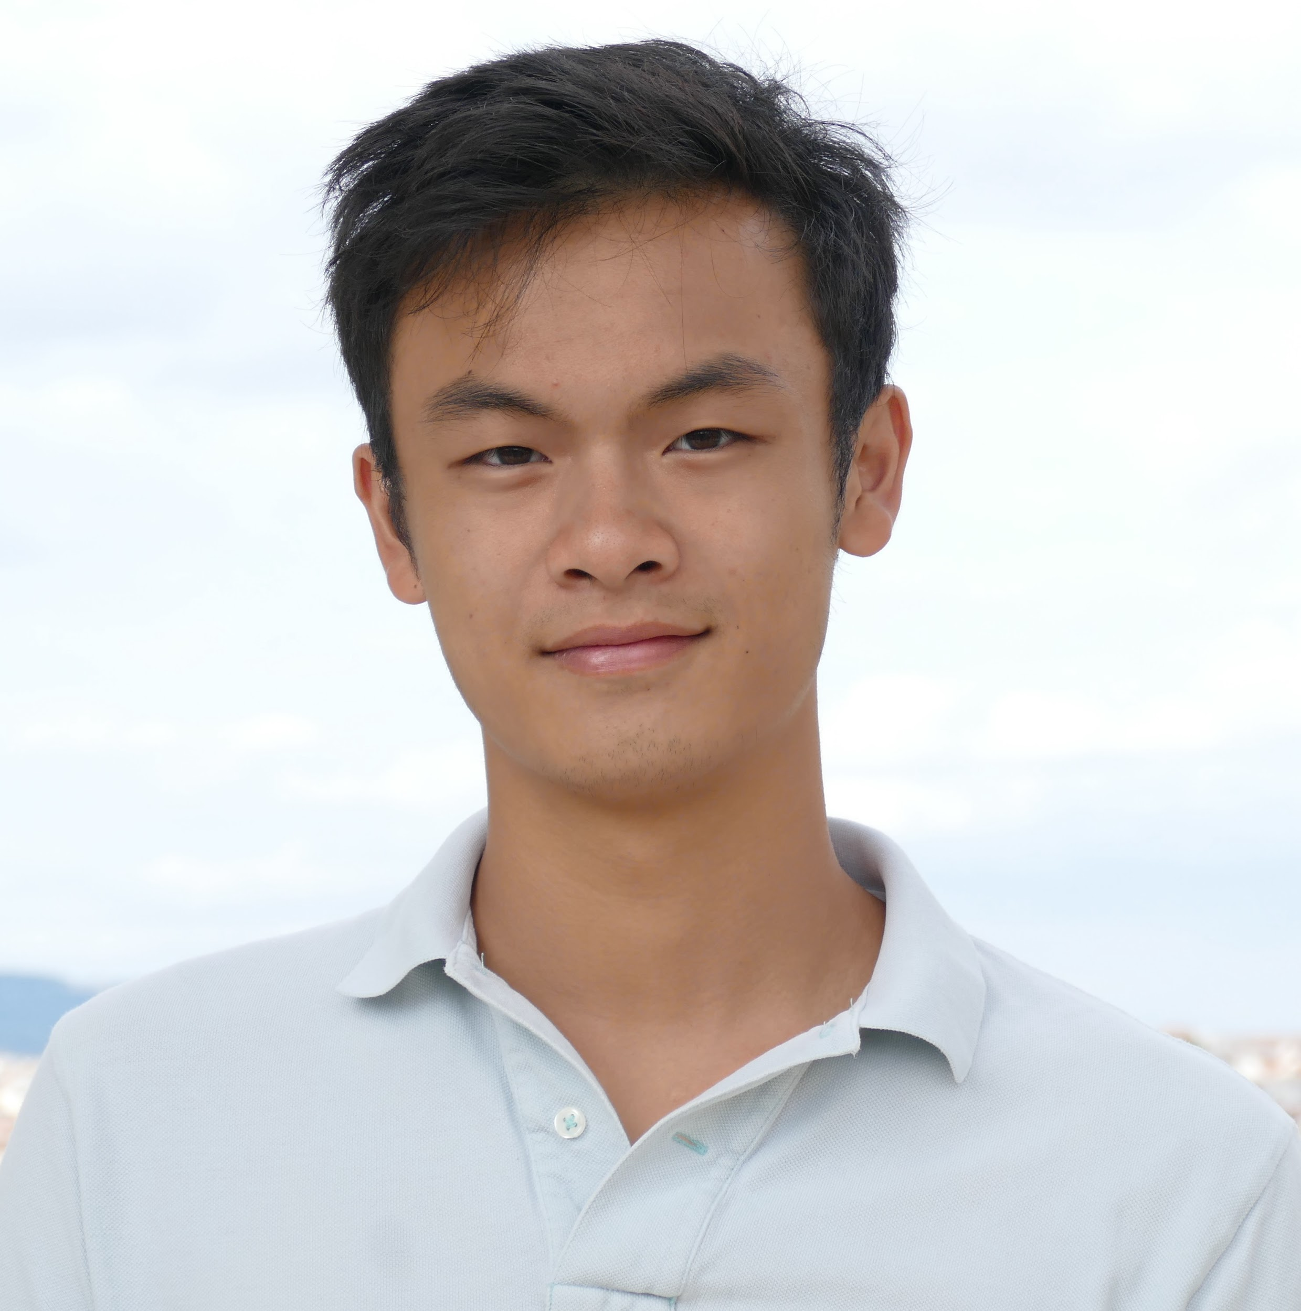
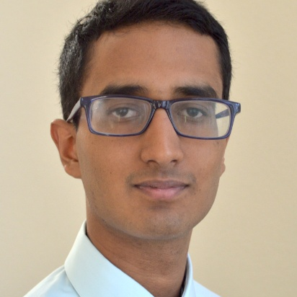
The team
Rohan Arya
Sitong Li
Derrin Ngo
Nathan Hoang
Abhinav Kasamsetty
Testing
Postman
Frontend
Frontend
Backend

Slide 3

Demonstration

Slide 4
Self Critique

Slide 5
What did we do well?
Successfully implemented pages with links
Visualizations
Robust backend API on AWS

Slide 6
What did we learn?
Frontend
React, JavaScript
Backend
Flask, AWS, SQL

Slide 7
What can we do better?
We could have better designs of each webpage.
We could have a better data source for doctor pictures.
We could also have more media for specialties.

Slide 8
Other Critique
Costly Commute

Slide 9
What did they do well?
Splash page
Interesting data about cities, commutes, and homes
Comparing instances is an interesting idea
Lot of images for each city

Slide 10
What did we learn from their website?
Information about commutes in various cities
Wage information in different cities
One visualization shows how average income and rent in a city are correlated.

Slide 11
What can they do better?
Faster load times
Better user interface for queries
Improved frontend responsiveness

